Slide 1
Planning and implementing storage, backup, and recovery services
Planning storage
Implementing and managing storage
Implementing Azure Content Delivery Networks
Implementing Azure Backup
Planning for and implementing Azure Site Recovery
Creating and configuring Azure storage
Using Azure file storage
Protecting data with Microsoft Azure Backup

Slide 2
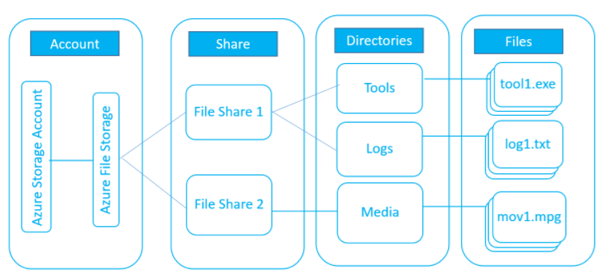
Planning storage
The following diagram illustrates the Azure Files management constructs:
Storage Account: All access to Azure Storage is done through a storage account.
Share: A File Storage share is an SMB file share in Azure. All directories and files must be created in a parent share. An account can contain an unlimited number of shares, and a share can store an unlimited number of files, up to the 5 TiB total capacity of the file share.
Directory: An optional hierarchy of directories.

Slide 3
File: A file in the share. A file may be up to 1 TiB in size.
URL format: For requests to an Azure File share made with the File REST protocol, files are addressable using the following URL format:

Slide 4
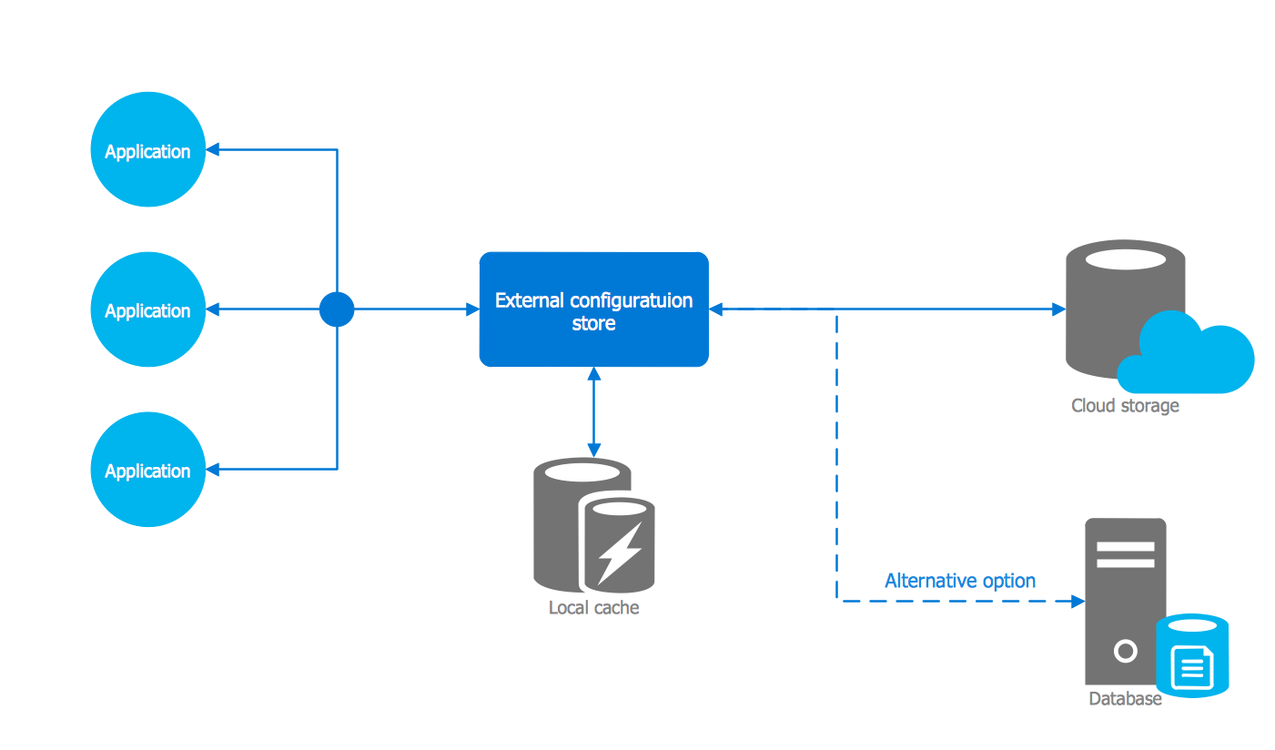
Implementing and managing storage
Sign in to the Azure portal.
In the Azure portal, expand the menu on the left side to open the menu of services, and choose More Services. Then, scroll down to Storage, and choose Storage accounts. On the Storage Accounts window that appears, choose Add.
Enter a name for your storage account.
Specify the deployment model to be used: Resource Manager or Classic. Resource Manager is the recommended deployment model. For more information,

Slide 5
Select the type of storage account: General purpose or Blob storage. General purpose is the default.
If General purpose was selected, then specify the performance tier: Standard or Premium. The default is Standard. For more details on standard and premium storage accounts.
If Blob Storage was selected, then specify the access tier: Hot or Cool. The default is Hot.
Select the replication option for the storage account: LRS, GRS, RA-GRS, or ZRS. The default is RA-GRS. For more details on Azure Storage replication options.
Select the subscription in which you want to create the new storage account.
Specify a new resource group or select an existing resource group. For more information on resource groups.for your storage account.
Click Create to create the storage account.

Slide 6
Manage your storage access keys
When you create a storage account, Azure generates two 512-bit storage access keys, which are used for authentication when the storage account is accessed. By providing two storage access keys, Azure enables you to regenerate the keys with no interruption to your storage service or access to that service.

Slide 7
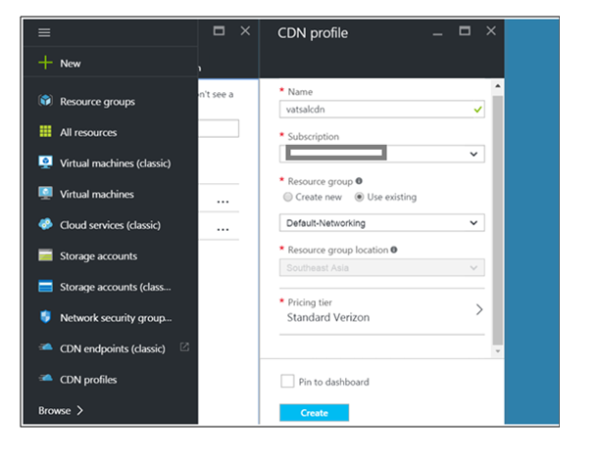
Implementing Azure Content Delivery Networks
Login to Azure Portal and click on Browse and search for CDN. Click on CDN Profile and "Add".
Enter a name for CDN Profile and select a Pricing Tier. You can choose between Premium, Verizon and Akamai

Slide 8
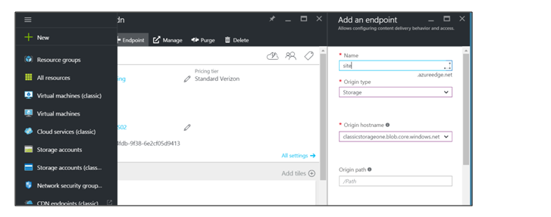
After the Profile is created, a CDN Endpoint is required
Click on the Profile and click on Endpoint. Enter a name for the endpoint and select the Origin
Here, we have selected the type as Storage as the data has been uploaded in a Storage Account

Slide 9
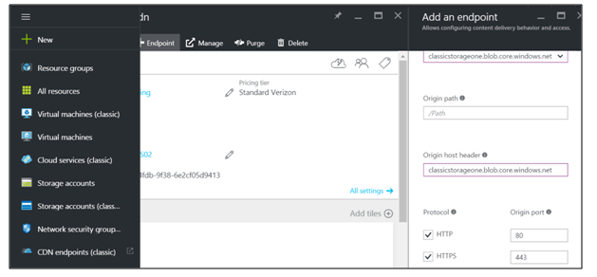
If needed, the "Origin Path" can be specified as the container of the Storage Account where the data is uploaded
By default, the Ports 80 & 443 are selected. These ports are used to access the CDN endpoint just created
Click on Add to create the CDN Endpoint. This might take around 90-120 minutes to propagate and the endpoint to be fully functional

Slide 10
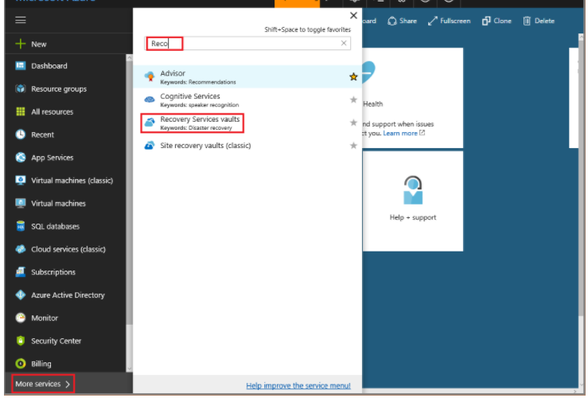
Implementing Azure Backup
Create a Recovery Services vault
The Recovery Services vault contains the backup data, and the backup policy applied to the protected virtual machines. Backing up virtual machines is a local process. You cannot back up a virtual machine from one location to a Recovery Services vault in another location. So, for each Azure location that has virtual machines to be backed up, at least one Recovery Services vault must exist in that location.
On the left-hand menu, select More services and in the services list, type Recovery Services. As you type, the list of resources filters. When you see Recovery Services vaults in the list, select it to open the Recovery Services vaults menu.

Slide 11
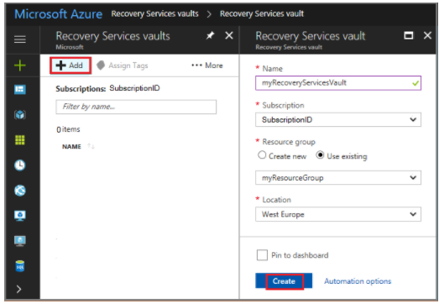
In the Recovery Services vaults menu, click Add to open the Recovery Services vault menu.
In the Recovery Services vault menu,
Type myRecoveryServicesVault in Name,
The current subscription ID appears in Subscription. If you have additional subscriptions, you could choose another subscription for the new vault.

Slide 12
A Recovery Services vault must be in the same location as the virtual machines being protected. If you have virtual machines in multiple regions,create a Recovery Services vault in each region. This tutorial creates a Recovery Services vault in West Europe because that is where myVM(the virtual machine created with the quickstart) was created.+
It can take several minutes for the Recovery Services vault to be created. Monitor the status notifications in the upper right-hand area of the portal. Once your vault is created, it appears in the list of Recovery Services vaults.

Slide 13
Planning for and implementing Azure Site Recovery
Create a vault
Create the vault in any region, except the source region.
Sign in to the Azure portal > Recovery Services.
Click New > Monitoring & Management > Backup and Site Recovery.
In Name, specify a friendly name to identify the vault. If you have more than one subscription, select the appropriate one.
Create a resource group or select an existing one.
To quickly access the vault from the dashboard, click Pin to dashboard and then click Create.

Slide 14
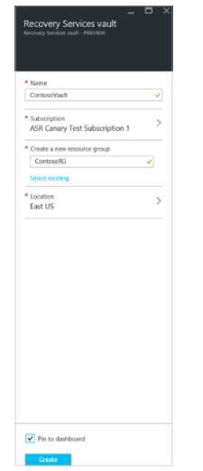
The new vault is added to the Dashboard under All resources, and on the main Recovery Services vaults page.

Slide 15
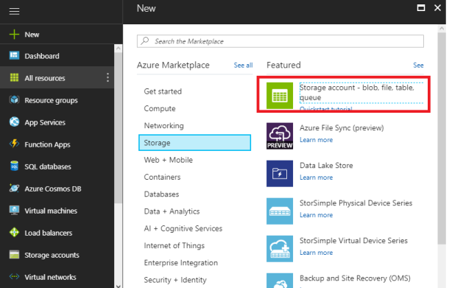
Creating and configuring Azure storage
New-Storage-Storage Account
Installing AzCopy
AzCopy is a command-line utility designed for copying data to and from Microsoft Azure Blob, File, and Table storage using simple commands
Download and install tool from here
Creating system variable for AzureCopy

Slide 16
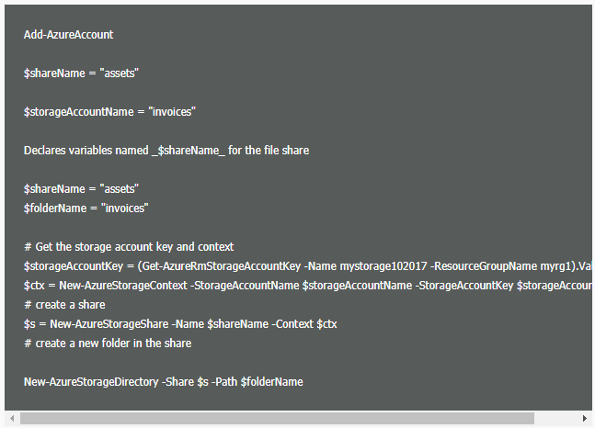
In system properties in advanced click Environment Variables
In system properties in advanced click Environment Variables
Under System variable click New
give variable a name and value (with quotes)
Sign Out and Sign in to apply changes and test it type %azcopy% in cmd
Creating folder in Azure

Slide 17
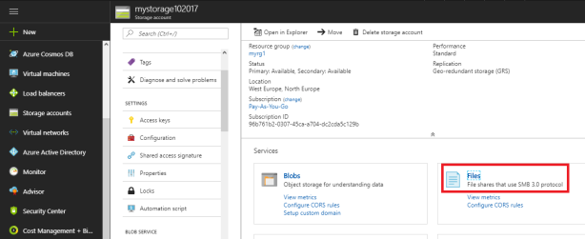
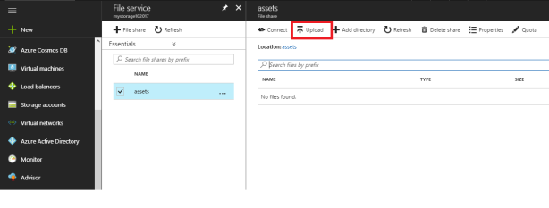
Upload files to Azure

Slide 18
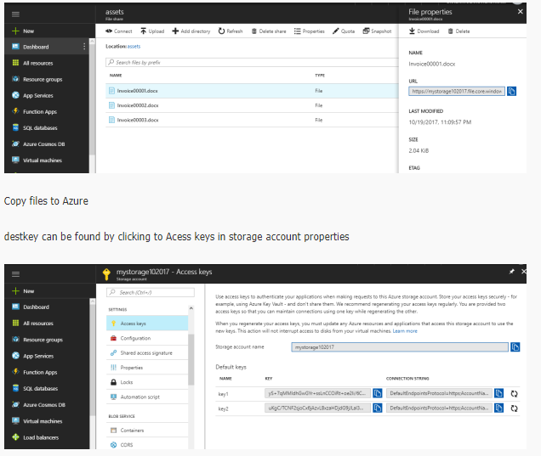

Slide 19
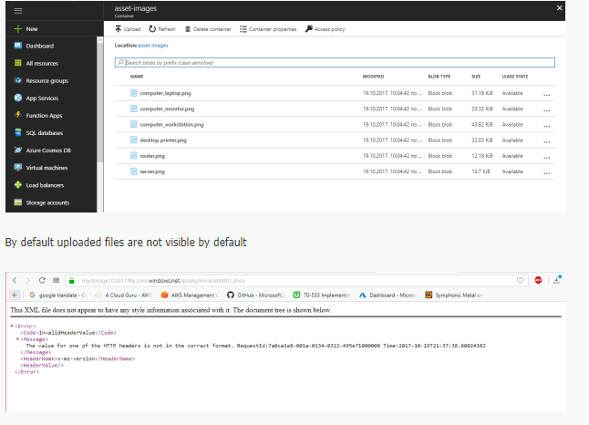

Slide 20
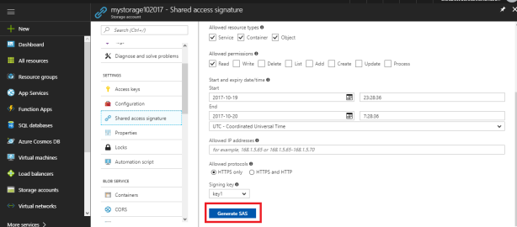
To enable access we need to create shared access signature (SAS)
by clicking Shared access signature, here we can set permission level-set SAS expiry date
Click Generate SAS and copy it somewhere

Slide 21
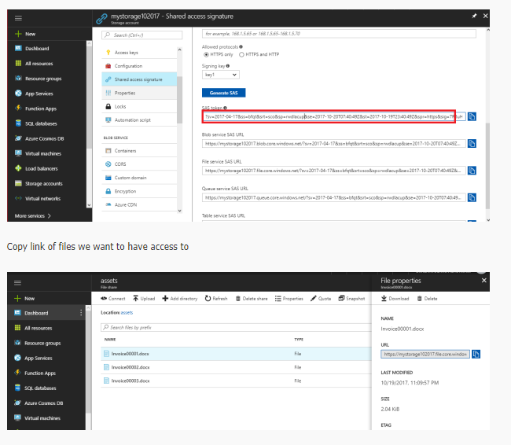

Slide 22
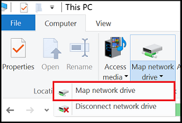
Open File Explorer: This can be done by opening from the Start Menu, or by pressing Win+E shortcut.
Navigate to the "This PC" item on the left-hand side of the window. This will change the menus available in the ribbon. Under the Computer menu, select "Map Network Drive".

Slide 23
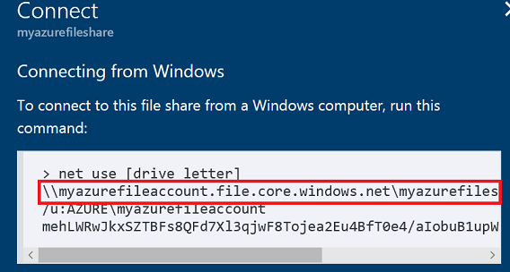
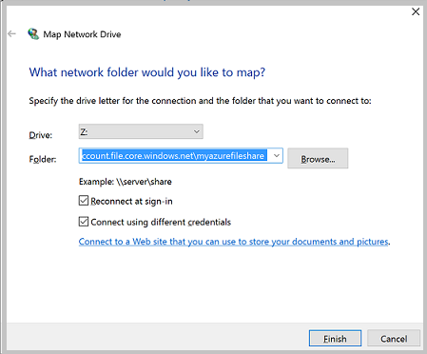
Copy the UNC path from the "Connect" pane in the Azure portal
Select the Drive letter and enter the UNC path.

Slide 24
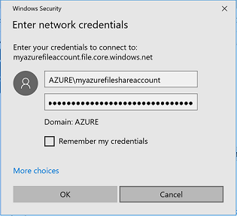
Use the Storage Account Name prepended with Azure\ as the username and a Storage Account Key as the password.
Use Azure File share as desired.
When you are ready to dismount (or disconnect) the Azure File share, you can do so by right clicking on the entry for the share under the "Network locations" in File Explorer and selecting "Disconnect".

Slide 25
Protecting data with Microsoft Azure Backup
Azure Backup delivers these key benefits:
Automatic storage management - Hybrid environments often require heterogeneous storage - some on-premises and some in the cloud. With Azure Backup, there is no cost for using on-premises storage devices. Azure Backup automatically allocates and manages backup storage, and it uses a pay-as-you-use model. Pay-as-you-use means that you only pay for the storage that you consume. For more information, see the Azure pricing article.
Unlimited scaling - Azure Backup uses the underlying power and unlimited scale of the Azure cloud to deliver high-availability - with no maintenance or monitoring overhead. You can set up alerts to provide information about events, but you don't need to worry about high-availability for your data in the cloud.
Multiple storage options - An aspect of high-availability is storage replication. Azure Backup offers two types of replication: locally redundant storage and geo-redundant storage. Choose the backup storage option based on need:

Slide 26
Locally redundant storage (LRS) replicates your data three times (it creates three copies of your data) in a paired datacenter in the same region. LRS is a low-cost option for protecting your data from local hardware failures.
Geo-redundant storage (GRS) replicates your data to a secondary region (hundreds of miles away from the primary location of the source data). GRS costs more than LRS, but GRS provides a higher level of durability for your data, even if there is a regional outage.
Unlimited data transfer - Azure Backup does not limit the amount of inbound or outbound data you transfer. Azure Backup also does not charge for the data that is transferred. However, if you use the Azure Import/Export service to import large amounts of data, there is a cost associated with inbound data. For more information about this cost, see Offline-backup workflow in Azure Backup. Outbound data refers to data transferred from a Recovery Services vault during a restore operation.

Slide 27
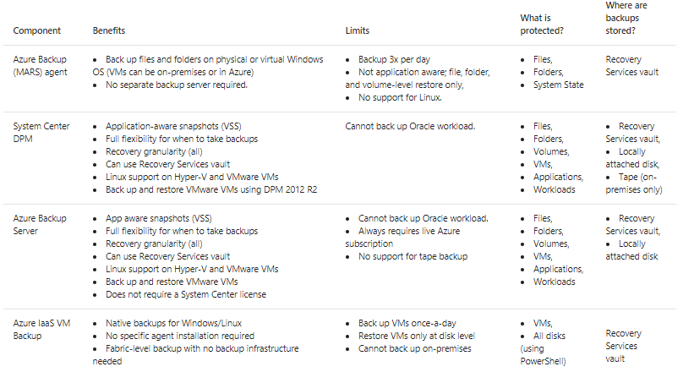
Which Azure Backup components should I use?

Slide 28
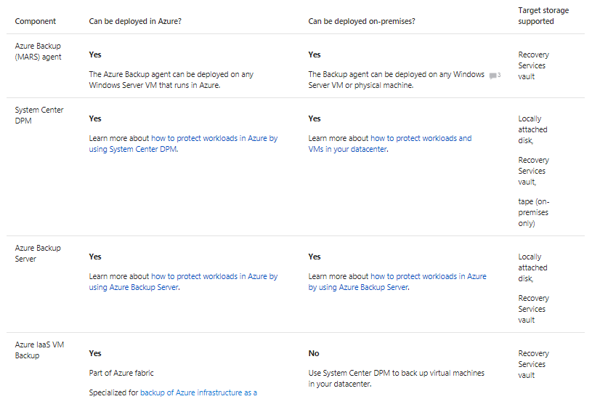
What are the deployment scenarios for each component?

